Slide 1
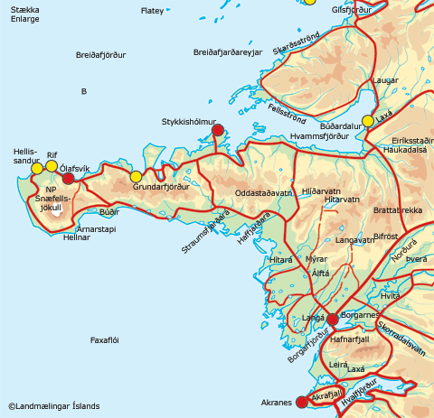
Vesturland

Slide 2
Akranes

Slide 3
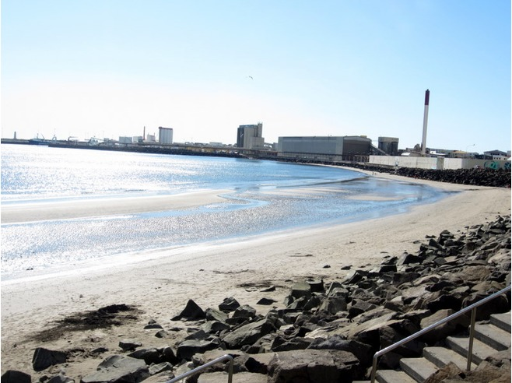
Akranes

Slide 4
Borganes

Slide 5
Hellisandur

Slide 6
Ólafsvík

Slide 7
Grundafjörður

Slide 8
Stykkishólmur

Slide 9
Búðardalur

Slide 10
Hellnar

Slide 11
Arnarstapi

Slide 12
Breiðafjarðareyjar

Slide 13
Flatey

Slide 14
Snæfellsjökull

